Slide 1
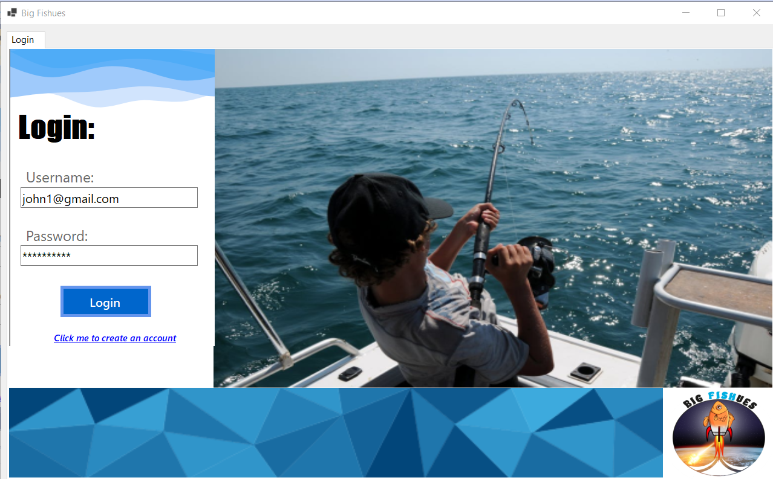
Login Page

Slide 2
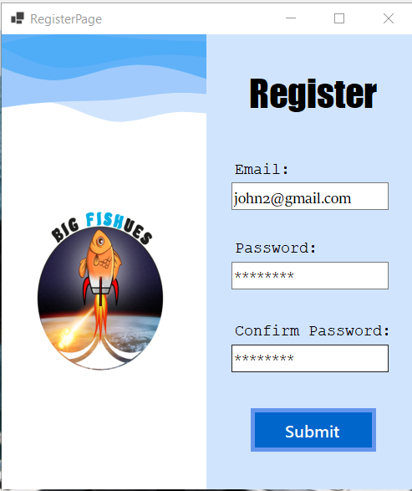
Register Account Page
This page opens in a new window alongside the Login screen, so a smaller size was chosen so both could fit onscreen at once

Slide 3
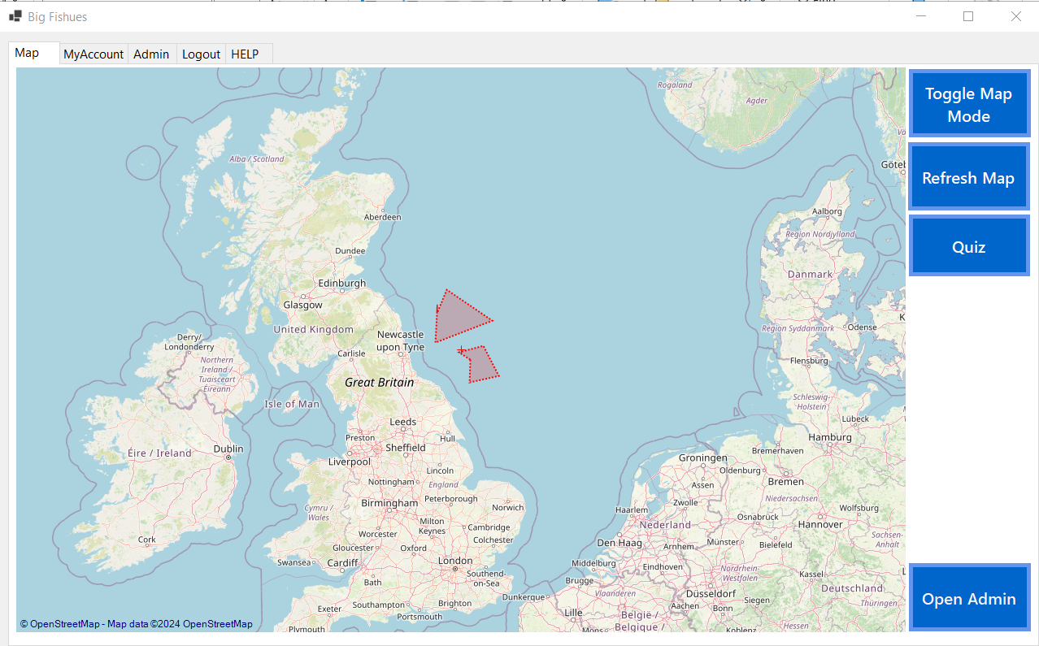
Map Page
This button only appears if you are logged in as an admin

Slide 4
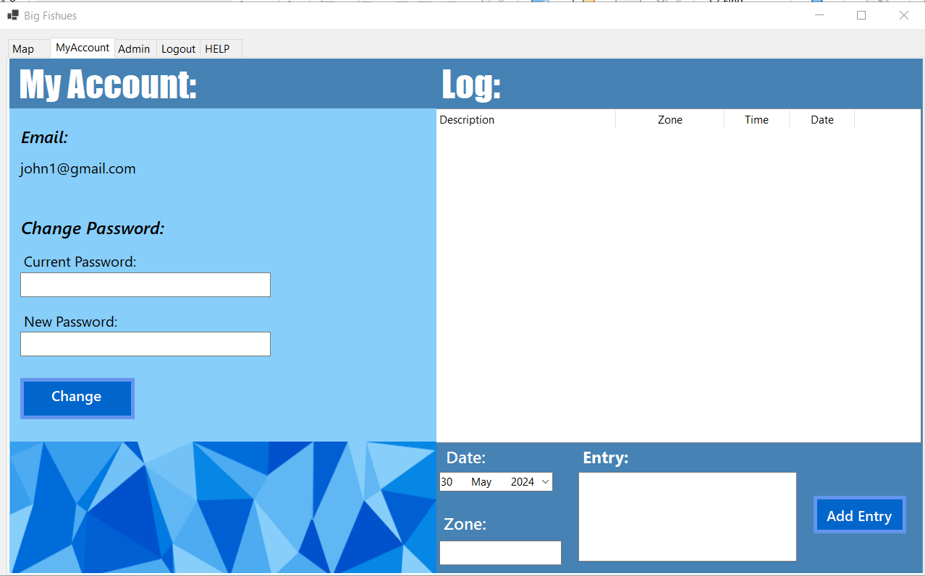
My Account Page

Slide 5
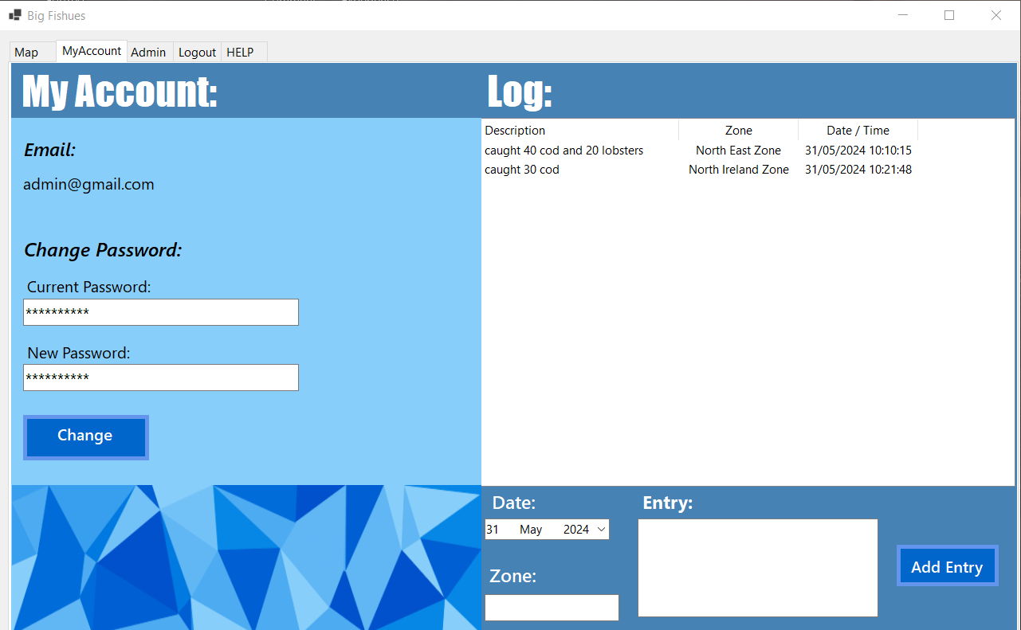
My Account Page-Log

Slide 6
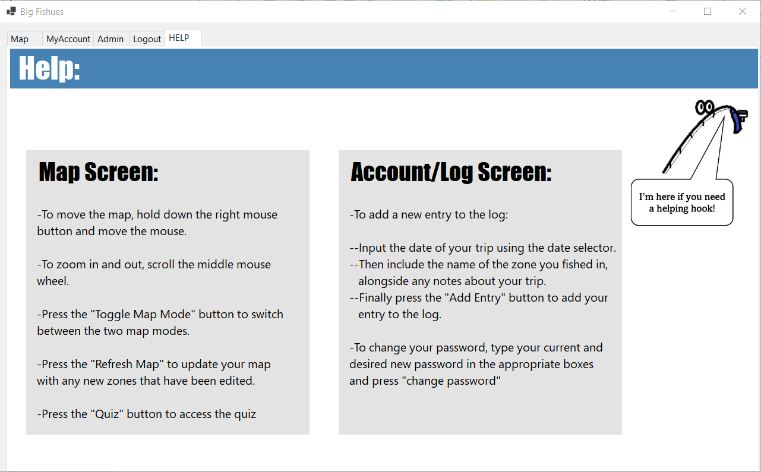
Help Page

Slide 7
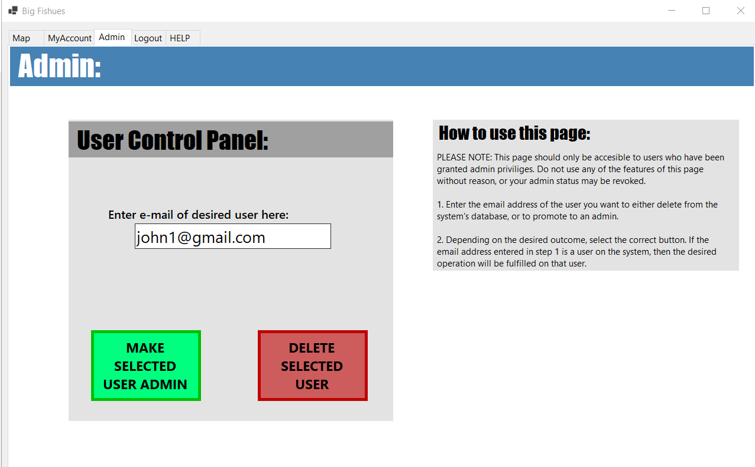
Admin Page

Slide 8
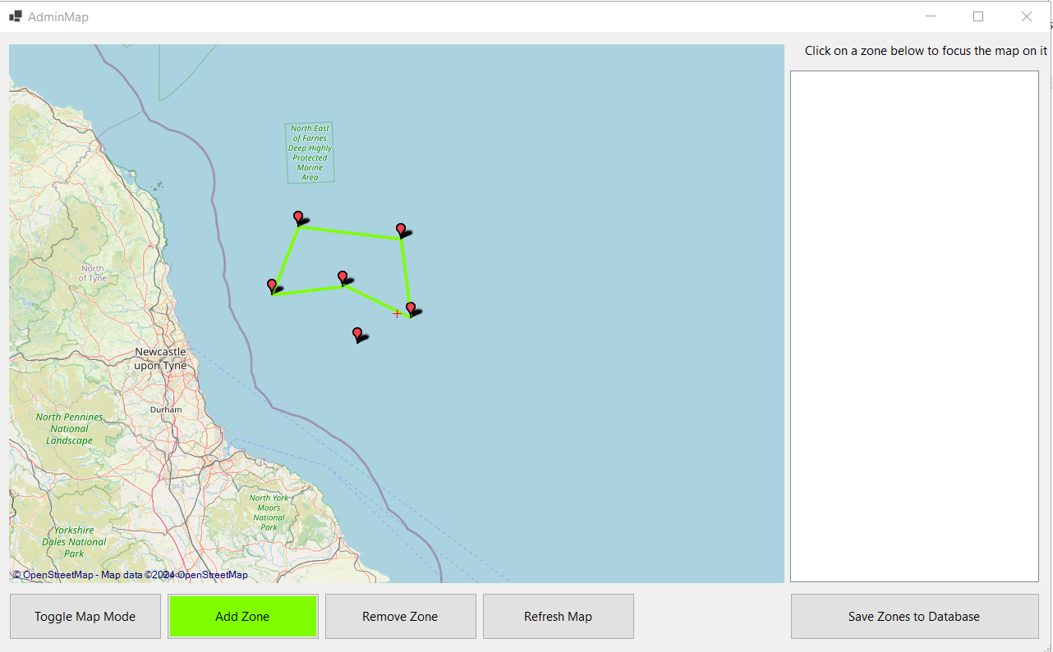
Admin Map Control Page-1
Admins can draw a new zone by clicking on desired points on the map

Slide 9
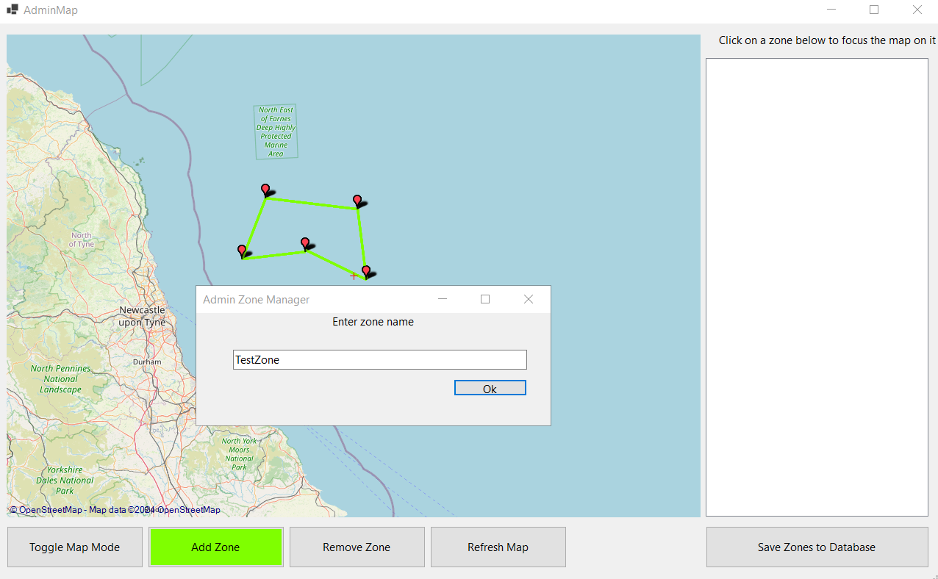
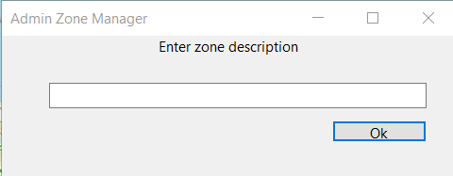
Admin Map Control Page-2
Zones can be named once they are drawn
They are also given a description for restrictions etc

Slide 10
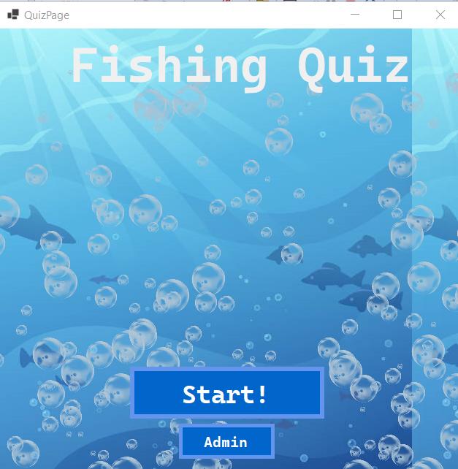
Quiz Page
Bubbles are animated

Slide 11
Contribution Matrix
Task | Tom (c2031226) | Camina (c20130457) | Owen (c20614119) | James (c20371038) | Aoife (c2037129) | Patrick
Login | C,M,T |  | M,R,T
Map |  | C,M,R,T
Log | C,T |  | M,R,T
Admin | C,R,T |  | M,R,T
Unit Testing | C,M,T |  | R | R
Bubble Class |  |  |  |  | C,T
Database Helper Class |  |  |  | C,M,R,T
Database Initialiser |  |  |  |  | C,M,R,T
Database Manager |  |  |  |  | C,M,R,T
Database Setup |  |  |  | C,M,R,T

Slide 12
Task | Tom (c2031226) | Camina (c20130457) | Owen (c20614119) | James (c20371038) | Aoife (c2037129) | Patrick
Quiz Class |  |  |  |  | C,M,R,T
Restriction Data Import Class |  | C,M,R,T
Session Manager Class |  |  |  |  | C,M,R,T
Utils Class |  | C,M,R,T
Validation Class |  |  |  |  | C,M,R,T
Zone Class |  | C,M,R,T

Slide 13
Task | Tom (c2031226) | Camina (c20130457) | Owen (c20614119) | James (c20371038) | Aoife (c2037129) | Patrick
Frontend-Login | C,M,R,T |  | M,R,T
Frontend-Map | C,M,T | M,R,T
Frontend-My Account | C,M,R,T |  | M,R,T
Frontend-Help | C,M,R
Frontend- Admin | C,M,R,T |  | M,R,T
Frontend-Quiz Page |  |  |  |  | C,M,R,T
Frontend-Register Page |  |  |  |  | C,M,R,T
Test Document |  |  |  |  | C,M,R

Slide 14
Task | Tom (c2031226) | Camina (c20130457) | Owen (c20614119) | James (c20371038) | Aoife (c2037129) | Patrick
Contribution Matrix | C,M,R | M | M
Coding Standards/Guidelines |  |  | C,M,R
README | M | C, M | M | M | M

